Slide 1
The Medical Examination
Data Analysis
Hyesu Kim_Hyejung Kim_Sunghwa Ryu_

Slide 2
Data collection

Slide 3
The medical examination information data
Context
건강검진정보 데이터는 2002년부터 2013년까지의 국민건강보험의 직장가입자와 40세 이상의 피부양자, 세대주인 지역가입자와 40세 이상의 지역가입자의 일반건강검진 결과와 이들 일반건강검진 대상자 중에 만40세와 만66세에 도달한 이들이 받게 되는 생애전환기건강진단 수검이력이 있는 각 연도별 수진자 100만 명에 대한 기본정보(성, 연령대, 시도코드 등)와 검진내역(신장, 체중, 총콜레스테롤, 혈색소 등)으로 구성된 개방데이터이다.
우리는 이 100만건의 데이터를 대상으로 한 데이터 마이닝을 통해 의미있는 정보를 찾아내고자 한다.
Source
공공데이터포털-건강검진정보(https://www.data.go.kr/dataset/15007122/fileData.do?lang=ko)

Slide 4
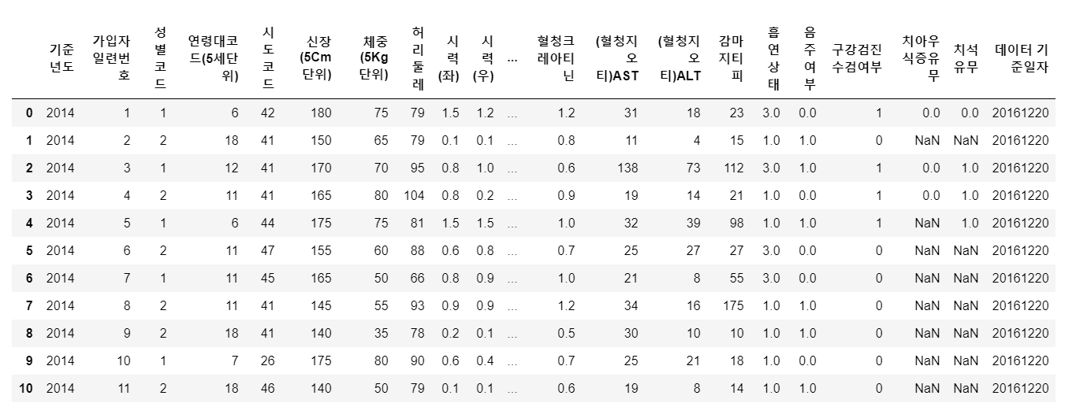
Data Preview
10,000,000 rows X 31 columns
Notes:
10,000,000 rows x 31 columns

Slide 5
Variables
No. | Variable Name in Korean | Variable Name in English | Definition | Normal Figure | Related disease
1 | 기준년도 | year | Baseline year (2014)
2 | 가입자일련번호 | memberID | Serial number of each member
3 | 성별 코드 | Sex | Male: 1, female: 2
4 | 연령 코드 | Age_group | ­Age grouped by 5 years between 20-84 years of age/ age of + 85 is in +85 group (total group number: 14)
5 | 시도 코드 | City_code | Residence city of each member
6 | 신장 | Height | Height of each member (unit: 5cm)

Slide 6
Variables
No. | Variable Name in Korean | Variable Name in English | Definition | Normal Figure | Related disease
7 | 체중 | Weight | Weight of each member (unit: kg)
8 | 허리둘레 | Waist | Waist of each member (unit: cm)
9 | 시력(좌) | sight_left | Between 0.1 ~ 2.5 value (below 0.1: 0.1, blindness: 9.9)
10 | 시력(우) | sight_right | ­Between 0.1 ~ 2.5 value (below 0.1: 0.1, blindness: 9.9)
11 | 청력(좌) | Hear_left (Ca) | Normal:1, anormal: 2
12 | 청력(우) | Hear_right (Ca) | Normal:1, anormal: 2

Slide 7
Variables
No. | Variable Name in Korean | Variable Name in English | Definition | Normal Figure | Related disease
13 | 수축기 혈압 | bp_high | Maximum blood pressure | Below 120mmHg
14 | 이완기 혈압 | bp_low | Minimum blood pressure | Below 80mmHg
15 | 식전 혈당(공복 혈당) | blds | Fasting blood sugar
16 | 총 콜레스테롤 | total_chole | ­Total cholesterol level | 150~250mg/dL
17 | 트리글리세라이드 | triglyceride | Triglyceride is a type of fat found in your blood | 30~135mg/dL | Heart disease
18 | HDL 콜레스테롤 | hdl_chole | The good kind of cholesterol | 30~65mg/dL
19 | LDL 콜레스테롤 | ldl_chole | The bad kind of cholesterol | Above 170mg/dL

Slide 8
Variables
No. | Variable Name in Korean | Variable Name in English | Definition | Normal Figure | Related disease
20 | 혈색소 | hmg | hemoglobin
21 | 요단백 (소변검사) | olig_prote_cd | Level of protein in urine: 1(-), 2(±), 3(+1), 4(+2), 5(+3), 6(+4)* | Less than 500mg/dL | Kidney disease
22 | 혈청크레아티닌 | creatinine |  | 0.8-1.7mg/dL
23 | (혈청지오티 ) AST | sgot_ast | ­ | 0~40IU/L
24 | (혈청지오티 ) ALT | sgpt_alt |  | 0~40IU/L
*+1(30mg/dL), +2(100mg/dL), +3(300mg/dL), +4(1000mg/dL)

Slide 9
Variables
No. | Variable Name in Korean | Variable Name in English | Definition | Normal Figure | Related disease
25 | 감마 지티피 | gamma_gtp |  | Male: 11~63IU/L, Female: 8~35IU/L
26 | 흡연 상태 | smoke | No-smoking:1, quitted:2, smoking:3
27 | 음주 여부 | drink_yn | No-drink:0, drink:1
28 | 구강검진 수검여부 | dent_exam_yn | No:0, yes:1
29 | 치아우식증 여부 | crs_yn | No:0, yes:1
30 | 치석 유무 | ttr_yn | No:0, yes:1
31 | 데이터 공개일자 | data | Baseline date for the data

Slide 10
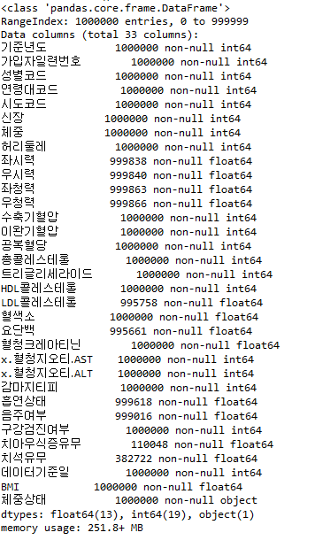
The derived variable
md = pd.read_csv("C:\Python\medical\medical.csv", engine="python")
md.info()
BMI = (체중) / (신장)^2
BMI < 18.5 <- "저체중"
18.5 <= BMI < 25.0 <- "정상"
25.0 <= BMI < 30.0 <- "과체중"
BMI >= 30.0 <- "비만"

Slide 11
Data exploration

Slide 12
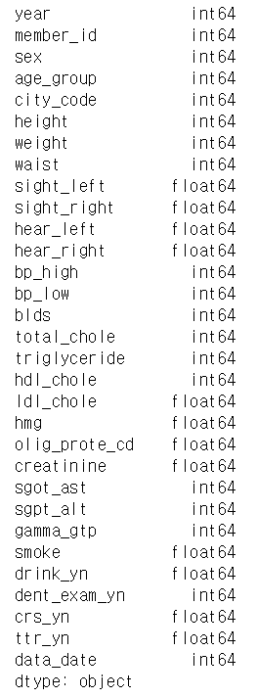
Basic exploration
medi1.shape
> (1000000, 31)
medi1.columns
> Index(['기준년도', '가입자일련번호', '성별코드', '연령대코드(5세단위)', '시도코드',
'신장(5Cm단위)', '체중(5Kg 단위)', '허리둘레', '시력(좌)', '시력(우)',
'청력(좌)', '청력(우)', '수축기혈압', '이완기혈압', '식전혈당(공복혈당)',
'총콜레스테롤', '트리글리세라이드', 'HDL콜레스테롤', 'LDL콜레스테롤',
'혈색소', '요단백', '혈청크레아티닌', '(혈청지오티)AST',
'(혈청지오티)ALT', '감마지티피', '흡연상태', '음주여부',
'구강검진 수검여부', '치아우식증유무', '치석유무', '데이터 기준일자'], dtype='object')
medi1.dtypes
> see the right side
>> most of variables are numeric

Slide 13
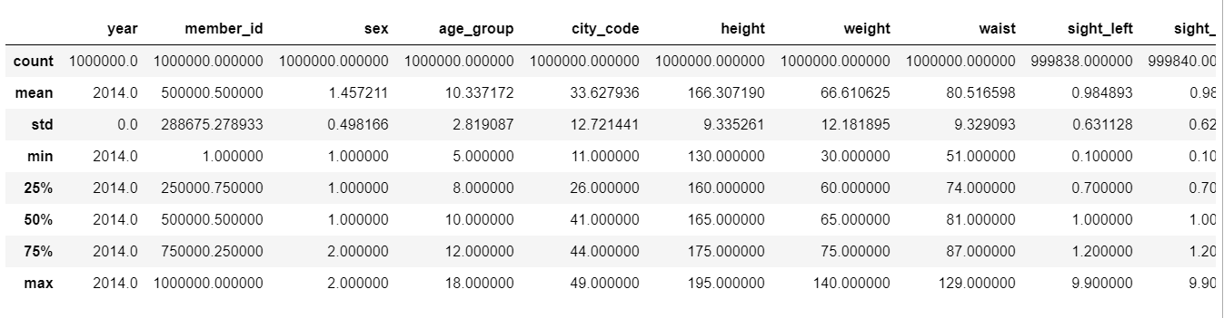
Basic exploration
medi1.describe
## Change to categorical variables :
list = ['sex', 'age_group', 'city_code', 'olig_prote_cd', 'smoke', 'drink_yn', 'dent_exam_yn', 'crs_yn', 'ttr_yn']
for i in list:
medi1[i] = medi1[i].astype('category')
print("the type of", i, medi1[i].dtypes)

Slide 14
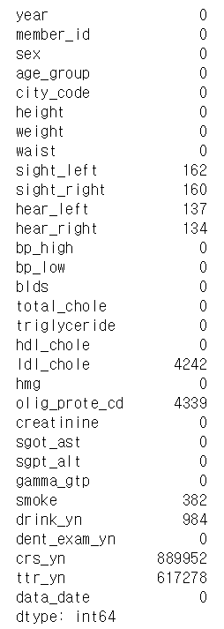
Missing values
medi1.info()
medi1.isnull().sum()
## Missing values:
Since there are only a few missing values in ‘sight_left’, ‘sight_right’, ‘hear_left’,
‘hear_right’, ‘ldl_chole’, ‘olig_prote_cd’, ‘smoke’, ‘drink_yn’, we might want to
drop them for the further analysis.
*In statistical language, if the number of the cases is less than 5% of the sample,
then the researcher can drop them.
There are many missing values in ‘crs_yn’ and ‘ttr_yn’ variables.
We assume that this is because people don’t exactly know whether they have
cavity or plaque when they were asked.
0.0162%
0.0160%
0.0137%
0.0134%
0.4242%
0.4339%
0.0382%
0.0984%
88.995%
61.728%

Slide 15
Outliers
Boxplot
Scatterplot

Slide 16
Boxplot
def boxplot(row, col, data, columns):
plt.figure()
plt.rcParams["figure.figsize"] = (20, 5*row)
count = row * col
color = ['#BBDEFB','#F8BBD0','#EBDEF0']
for i in range(count):
plt.subplot(row, col, i+1)
ax = sns.boxplot(columns[i], data=data, palette=[color[i%3]])
plt.show()
columns = ['HEIGHT', 'WEIGHT', 'WAIST', 'BODY_CONDITION']
boxplot(4,1,medical,columns)

Slide 17
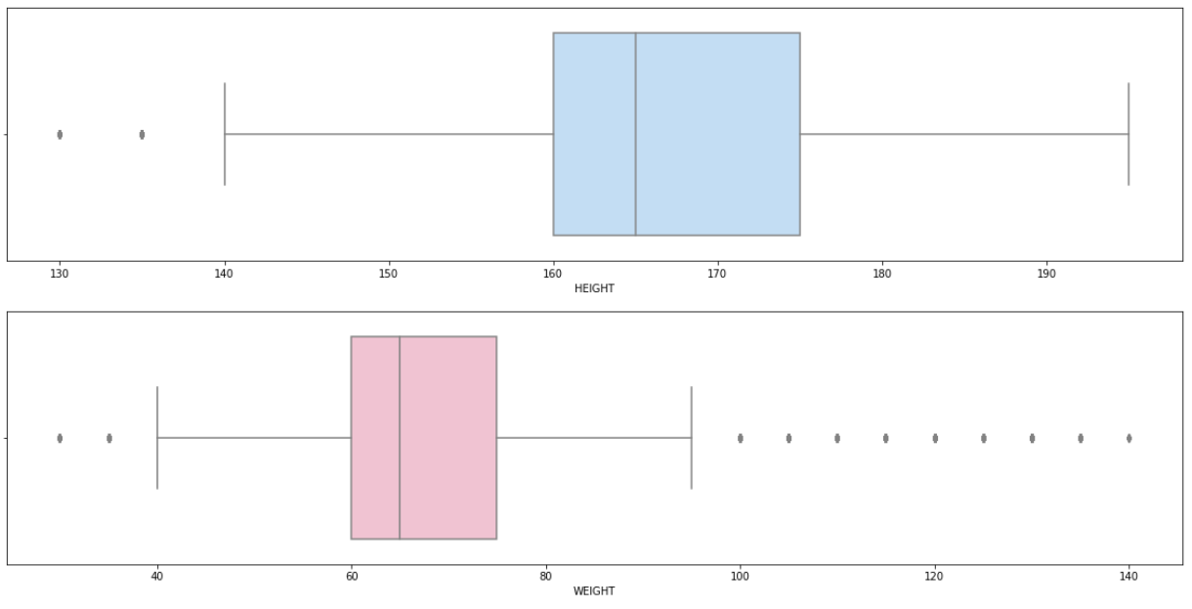
Height and Weight
100kg or more : 13,385

Slide 18
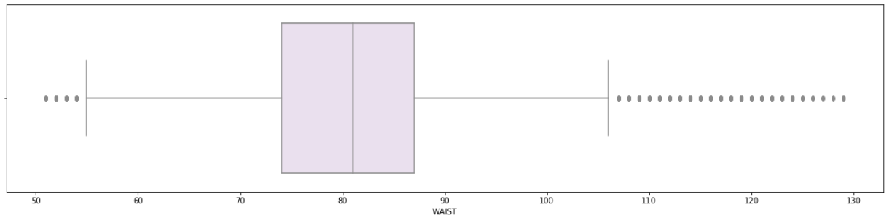
Waist
90cm or more : 164,695

Slide 19
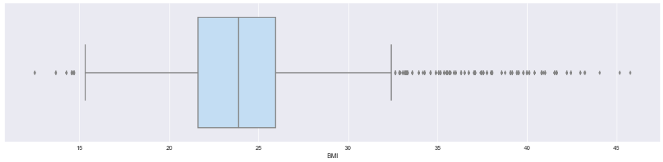
BMI
Less than 18.5 : 33,324
More than 25 : 333,212
More than 35 : 3,554

Slide 20
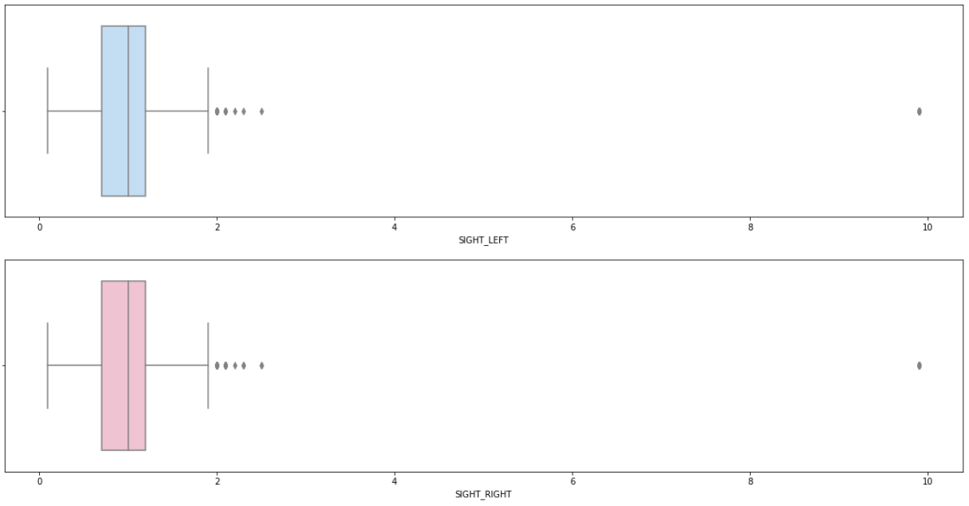
Eyesight
Loss of Left Eyesight : 3,455 Loss of Right Eyesight : 3,338
Loss of Both Eyesight : 515

Slide 21
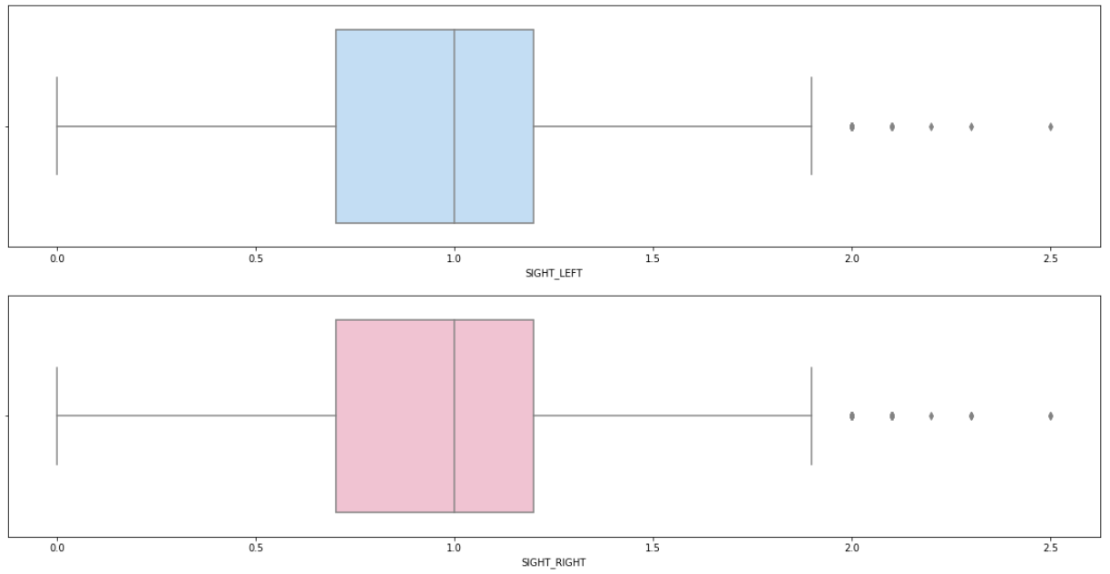
Eyesight

Slide 22
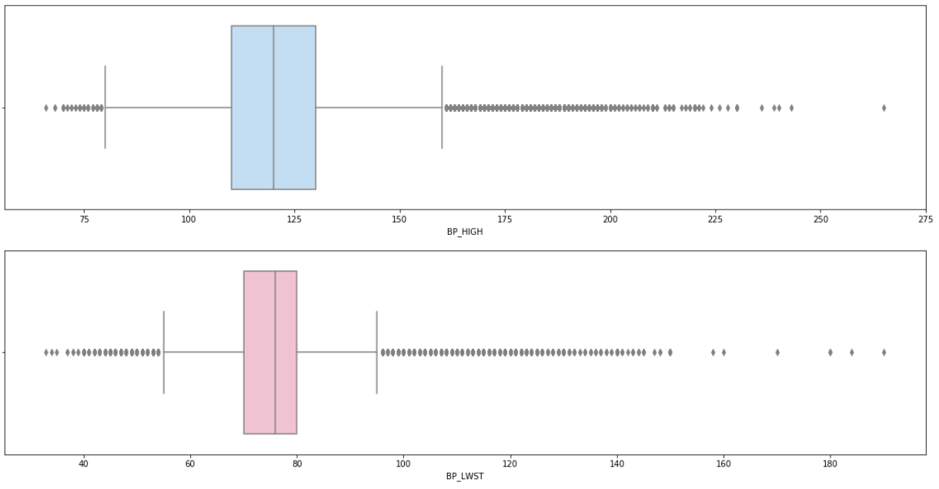
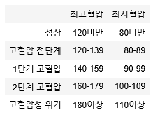
Blood Pressure
BP Hiht 180 or more : 1,832
BP lwst 110 or more : 4,146

Slide 23
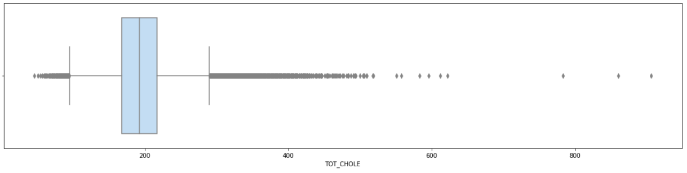
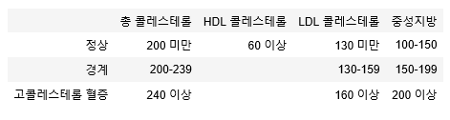
Total Cholesterol
Total cholesterol 240 or more : 109,825
Total cholesterol 400 or more : 149

Slide 24
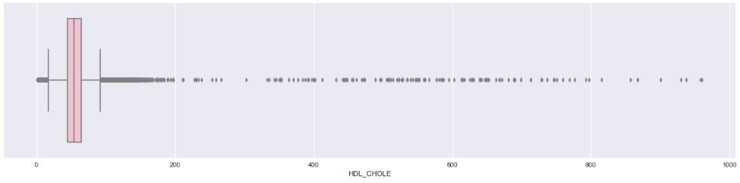
HDL Cholesterol
HDL cholesterol less than 60 : 658,854
HDL cholesterol 200 or more : 130
HDL cholesterol 400 or more : 102

Slide 25
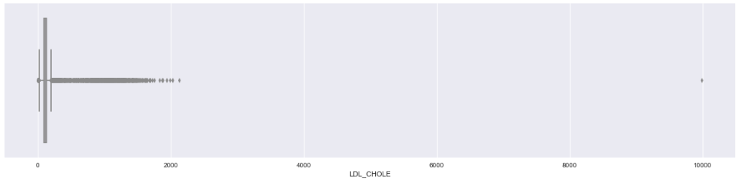
LDL Cholesterol
LDL cholesterol 160 or more : 88,964
LDL cholesterol 200 or more : 12,165
LDL cholesterol 400 or more : 593
LDL cholesterol 1000 or more : 314

Slide 26
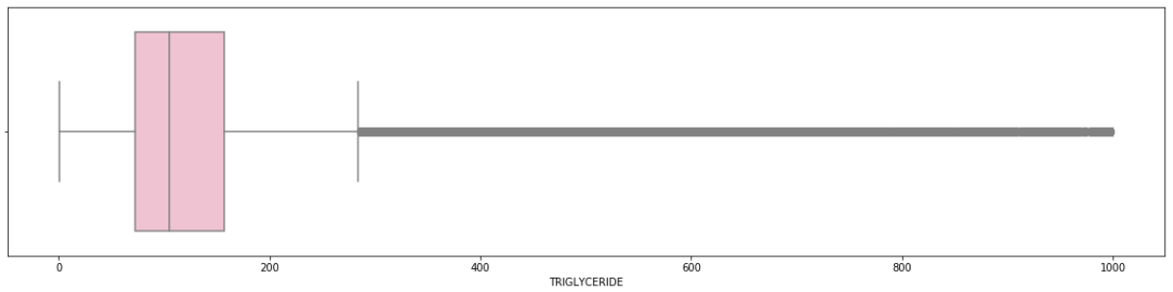
Triglycerides
Triglycerides 200 or more : 146,529
Triglycerides 400 or more : 18,830
Triglycerides 600 or more : 4,751
Triglycerides 800 or more : 1,393

Slide 27
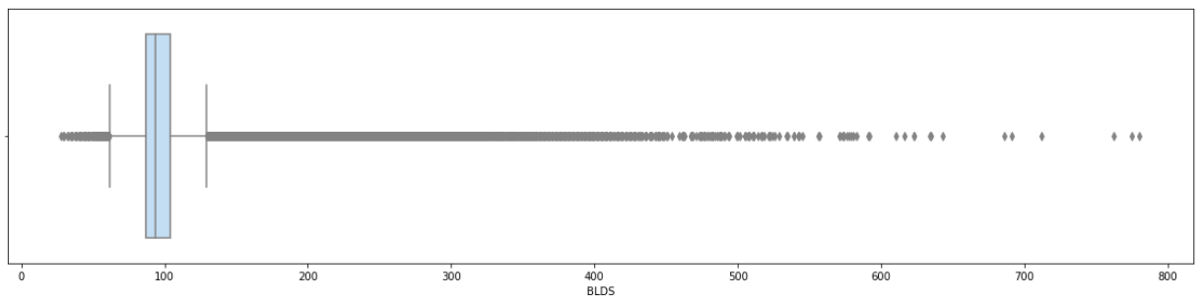
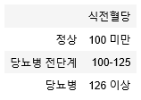
Fasting blood sugar
Fasting blood sugar 126 or more : 68,990
Fasting blood sugar 200 or more : 10,098
Fasting blood sugar 400 or more : 230

Slide 28
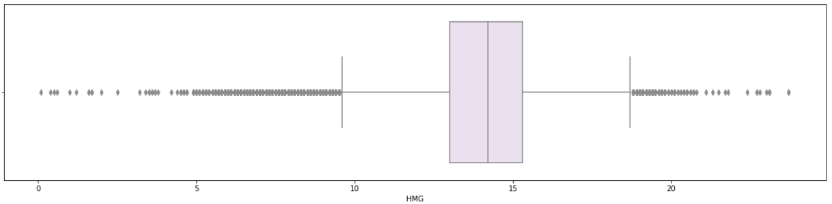
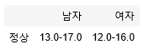
Hemoglobin
Hemoglobin 17 or more : 27,459 Hemoglobin 20 or more : 47
Hemoglobin less than 12 : 82,187 Hemoglobin less than 8 : 1,702

Slide 29
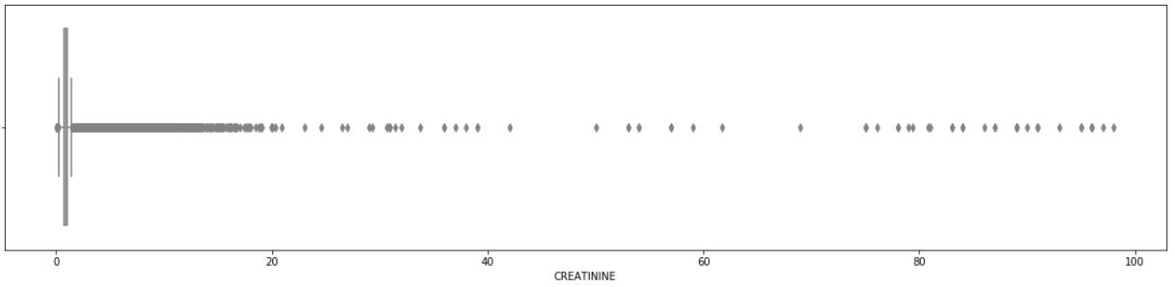
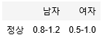
Creatinine
Creatinine 1.2 or more : 80,192 Creatinine 2.0 or more : 2,842
Creatinine 20.0 or more : 68 Creatinine less than 0.5 : 8330

Slide 30
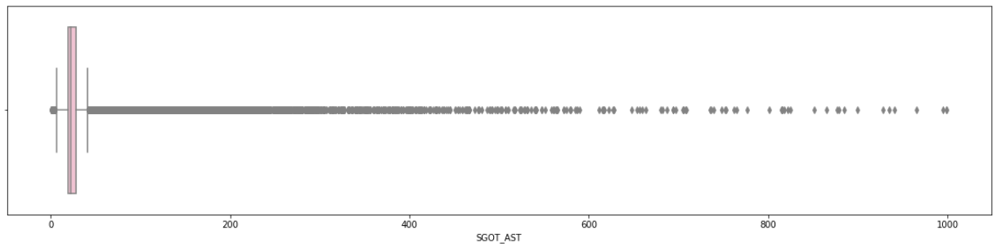
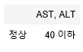
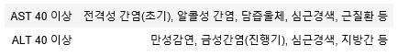
AST
AST 40 or more : 71,634 AST 100 or more : 4,999 AST 200 or more : 995

Slide 31
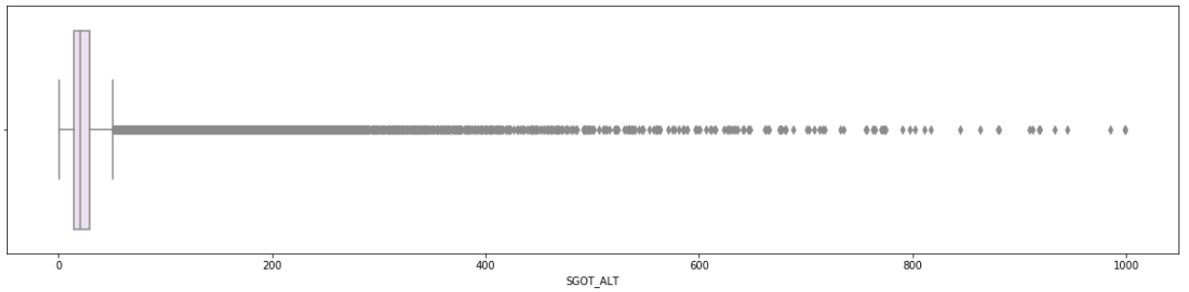
ALT
ALT 40 or more : 122,229 ALT 100 or more : 10,617 ALT 200 or more : 1,340

Slide 32
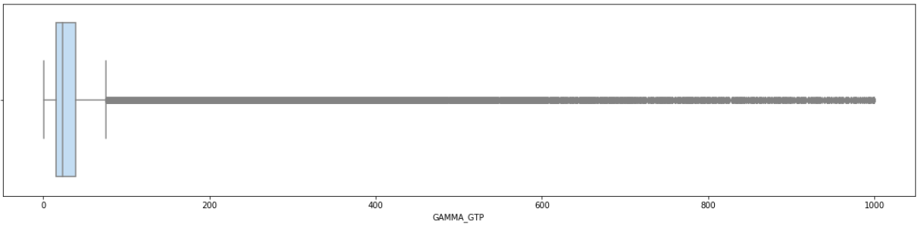
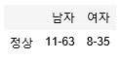
Gamma GTP
Gamma GTP (male) 63 or more : 104,769 Gamma GTP (female) 35 or more : 52,523
Gamma GTP 100 or more : 53,483 Gamma GTP 200 or more : 12,994
Gamma GTP 300 or more : 5,405

Slide 33
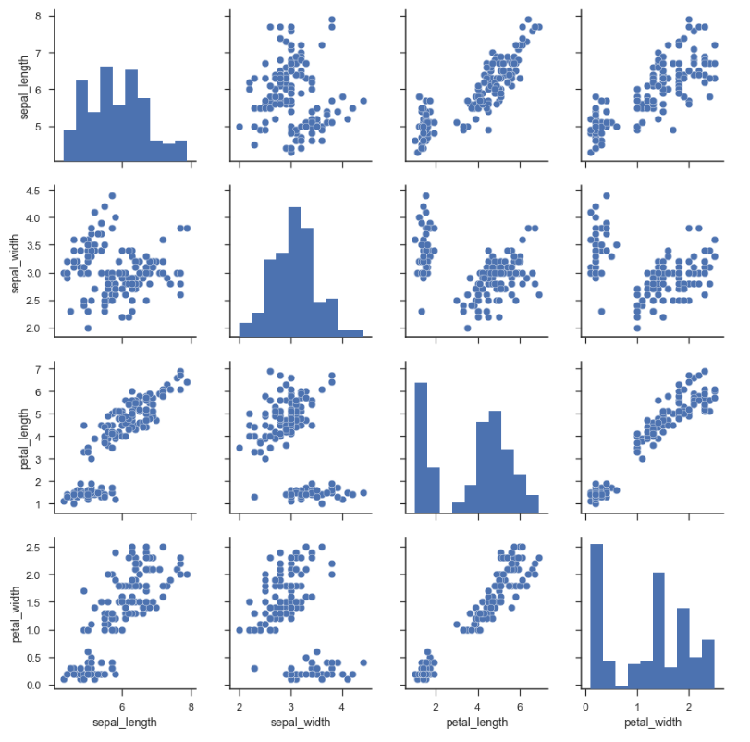
Scatterplot
c = ['sex', 'age_group', 'city_code', 'height', 'weight', 'waist', 'bp_high', 'bp_low', 'blds', 'total_chole', 'triglyceride','hdl_chole', 'ldl_chole', 'hmg', 'olig_pr', 'creatinine', 'sgot_ast', 'sgpt_alt', 'gamma_gtp', 'smoke', 'drink_yn', 'dent_exam_yn']
medi2 = medi1[c]
sns.pairplot(medi2)
## Take so much time to have the result but it should be like this >>>

Slide 34
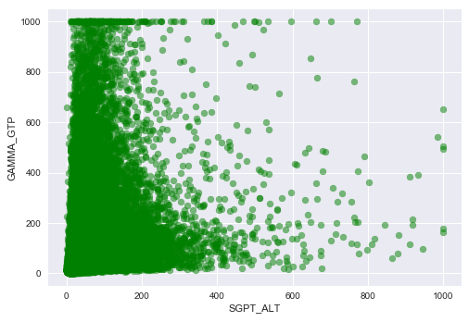
Scatterplot
def pltscatter(x, y):
plt.scatter(x, y, c = "g", alpha = 0.5, label = "")
plt.xlabel(x.name)
plt.ylabel(y.name)
plt.legend(loc = 2)
plt.show()
pltscatter(md["SGPT_ALT"], md["GAMMA_GTP"])

Slide 35
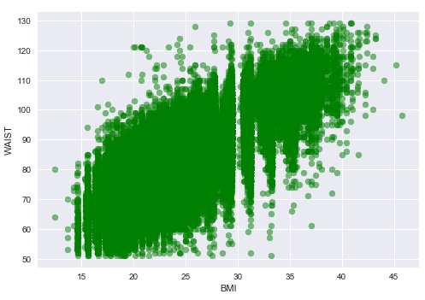
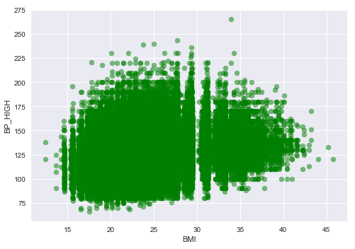
Scatterplot
pltscatter(md["BMI"], md["WAIST"])
pltscatter(md["BMI"], md["BP_HIGH"])

Slide 36
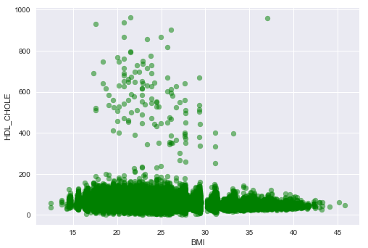
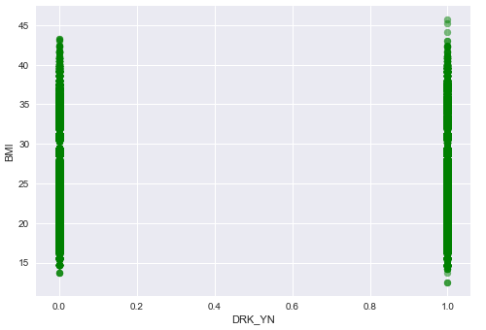
Scatterplot
pltscatter(md["BMI"], md["HDL_CHOLE"])
pltscatter(md["DRK_YN"], md["BMI"])

Slide 37
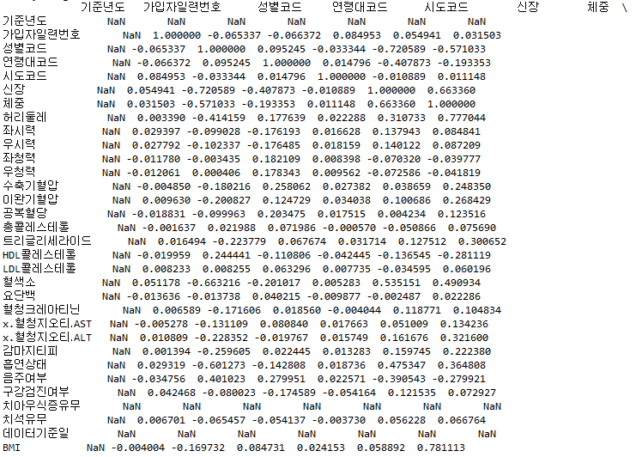
The correlation
re = md.corr(method='pearson')
print(re)

Slide 38
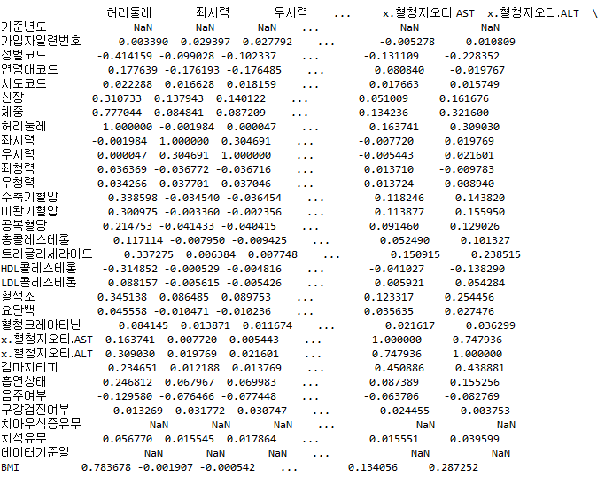
The correlation

Slide 39
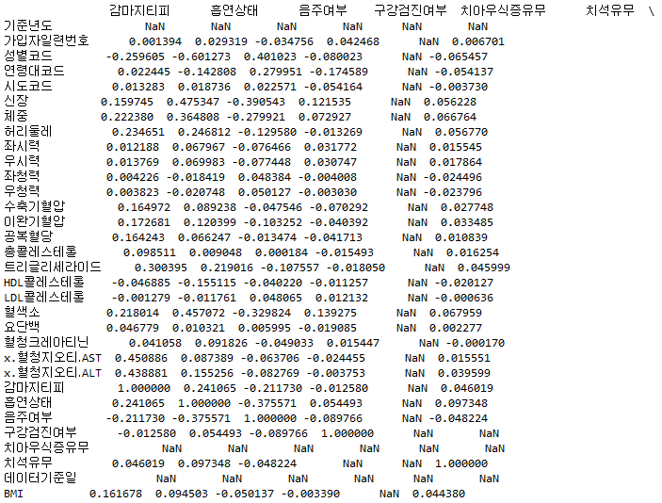
The correlation

Slide 40
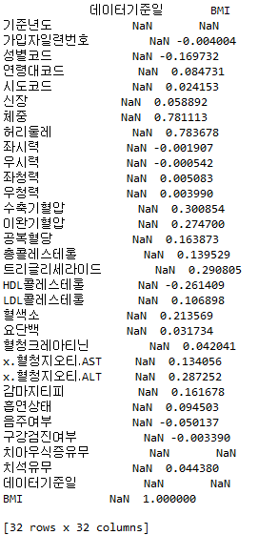
The correlation

Slide 41
Data Visualisation
Histogram
Barplot

Slide 42
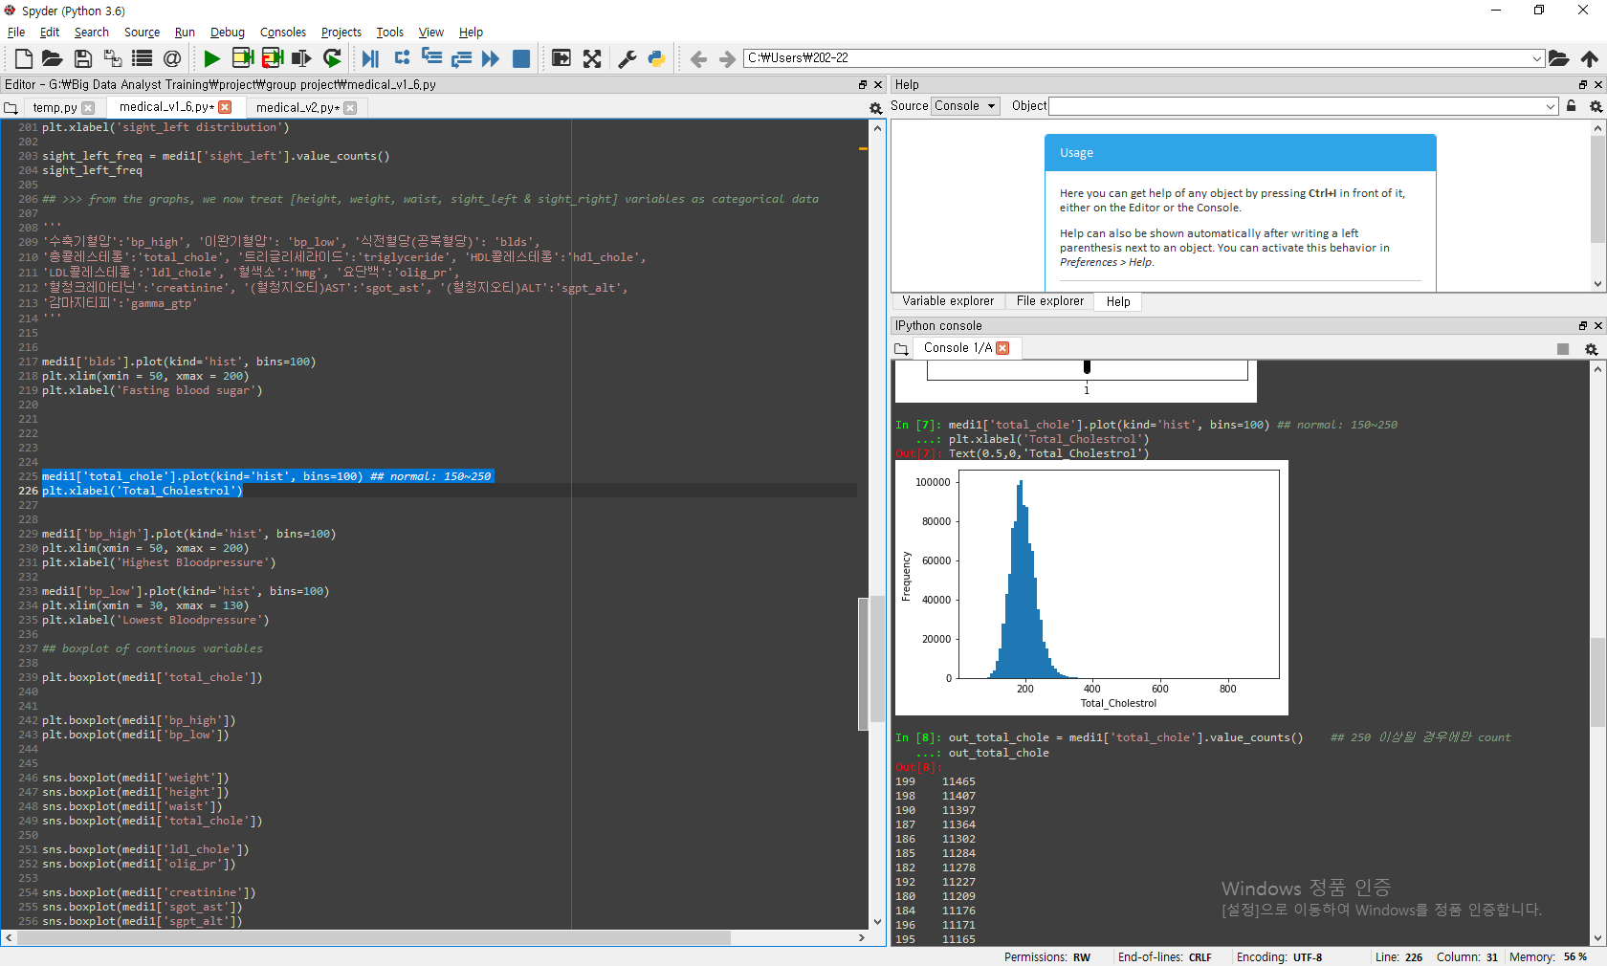
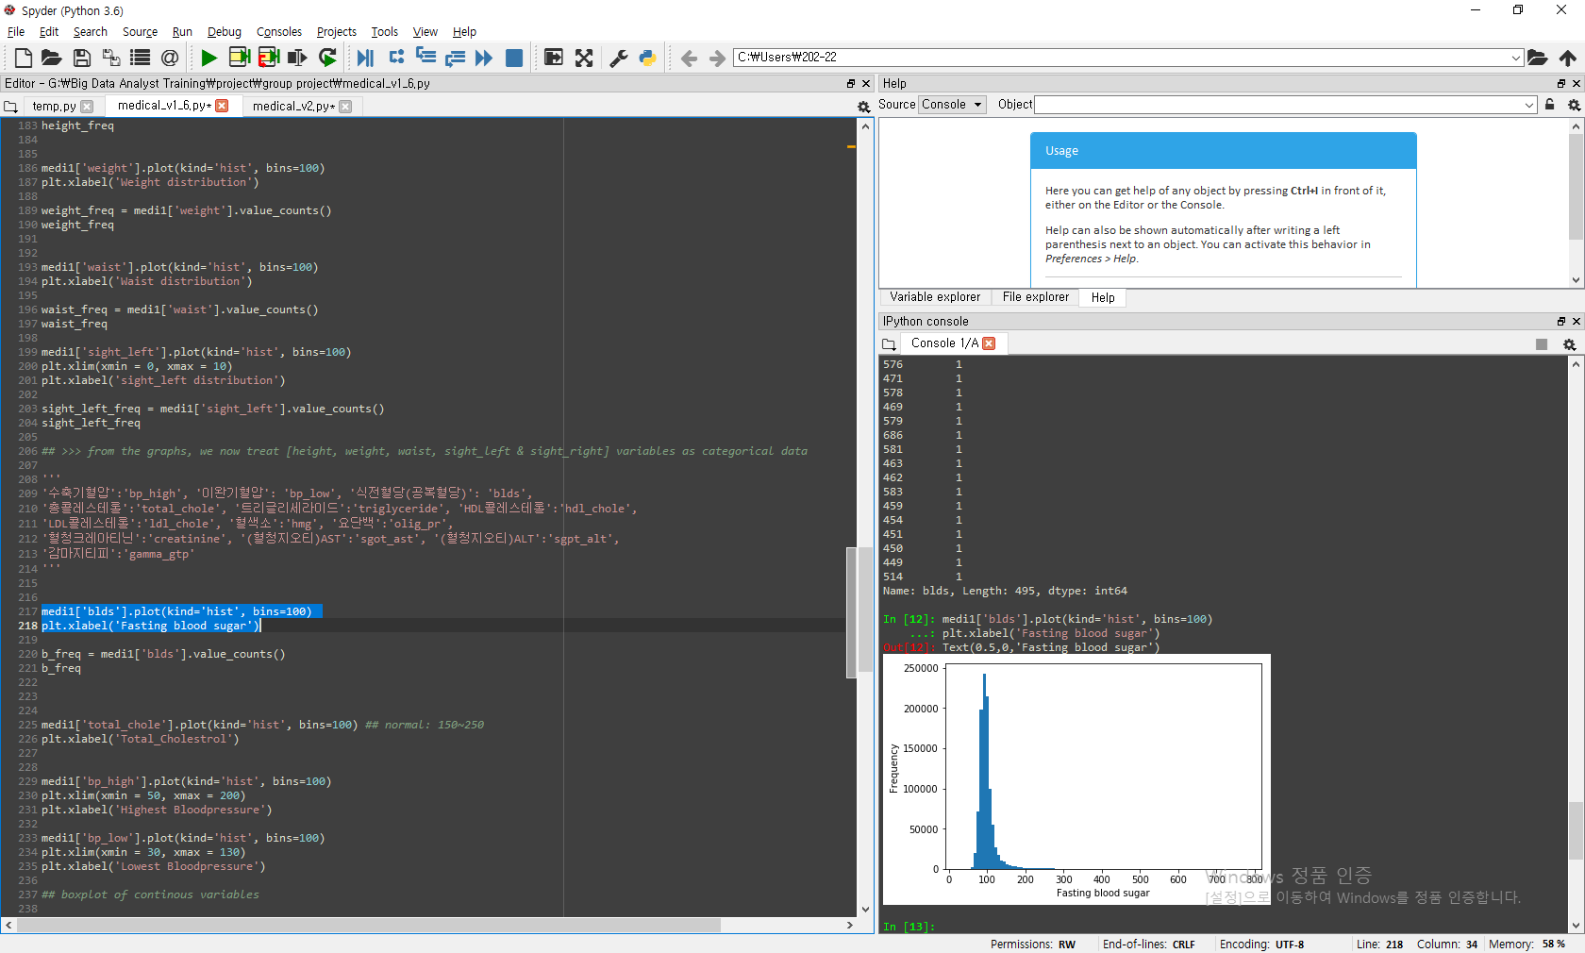
Histogram
medi1['blds'].plot(kind='hist', bins=100)
plt.xlabel('Fasting blood sugar')
medi1['total_chole'].plot(kind='hist', bins=100)
plt.xlabel('Total_Cholestrol')

Slide 43
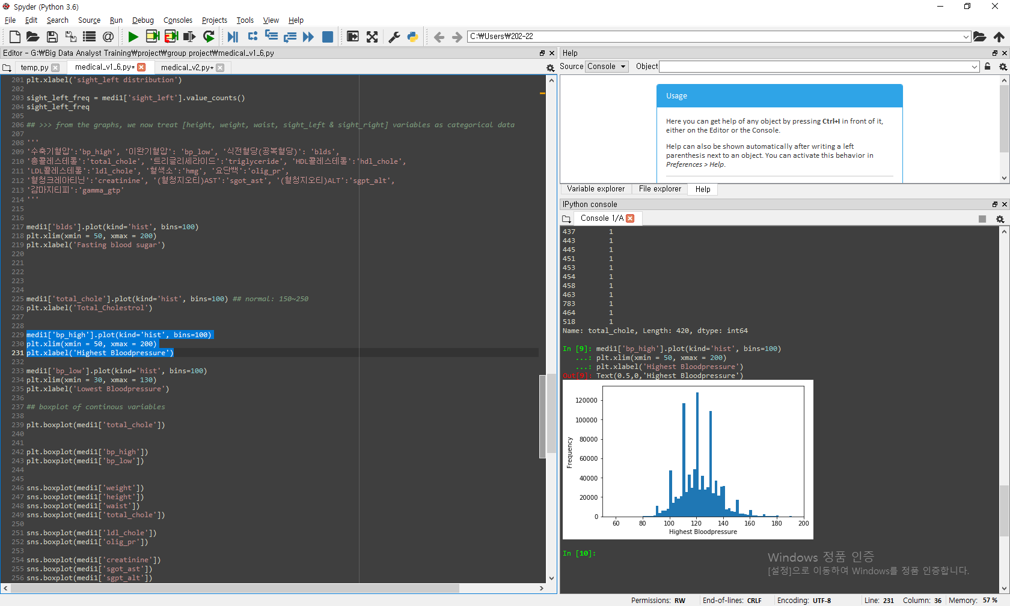
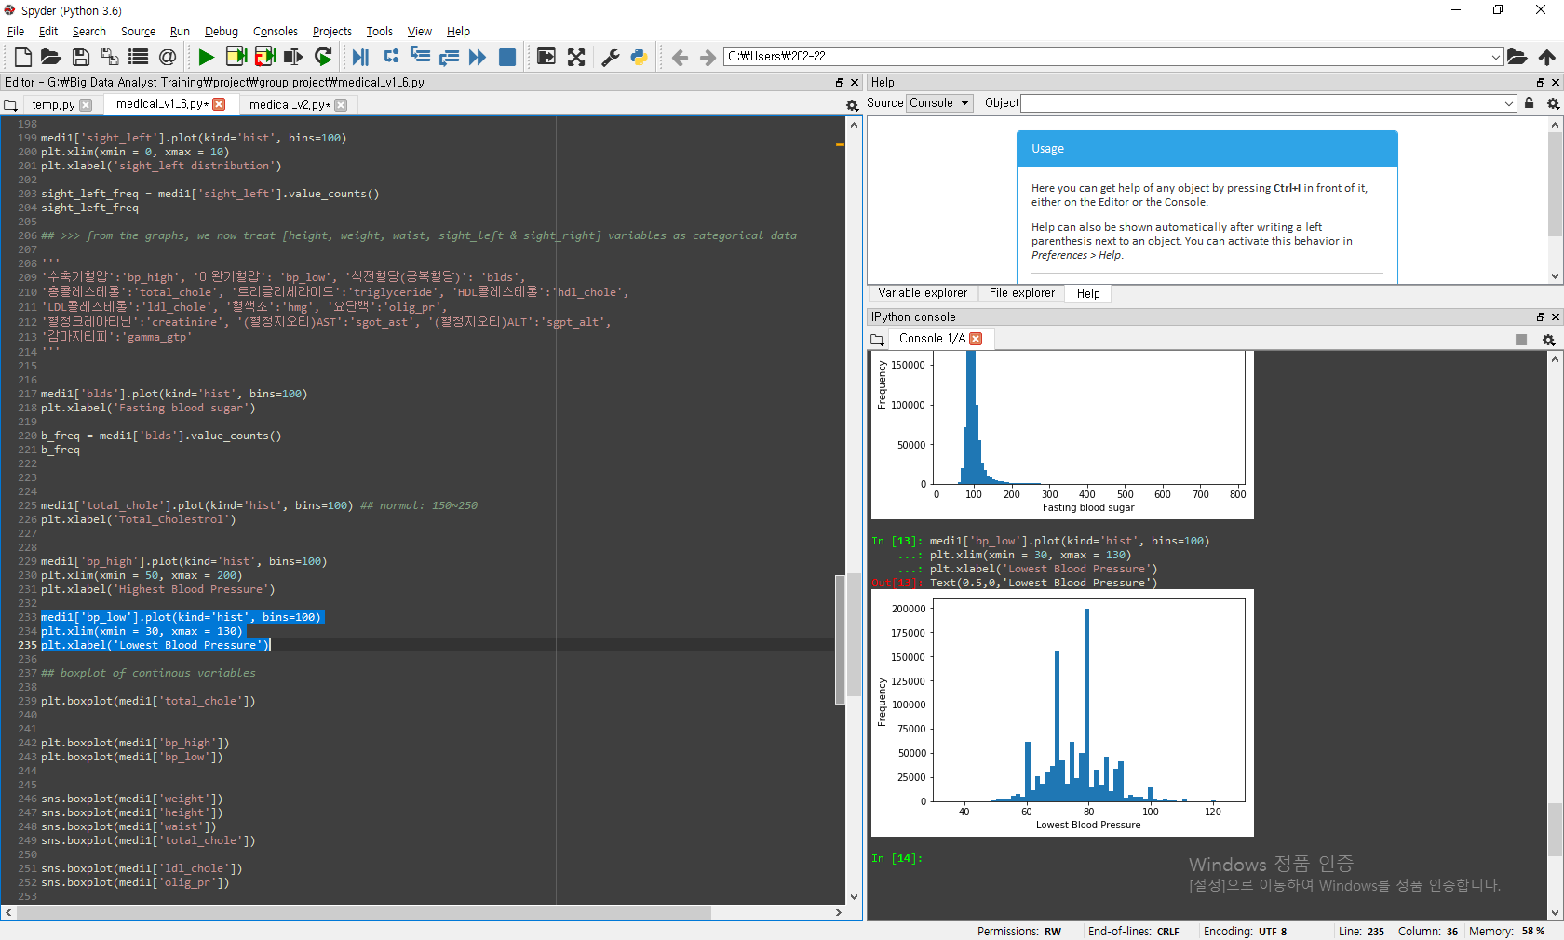
Histogram
medi1['bp_low'].plot(kind='hist', bins=100)
plt.xlim(xmin = 30, xmax = 130)
plt.xlabel('Lowest Blood Pressure')
medi1['bp_high'].plot(kind='hist', bins=100)
plt.xlim(xmin = 50, xmax = 200)
plt.xlabel('Highest Blood Pressure')

Slide 44
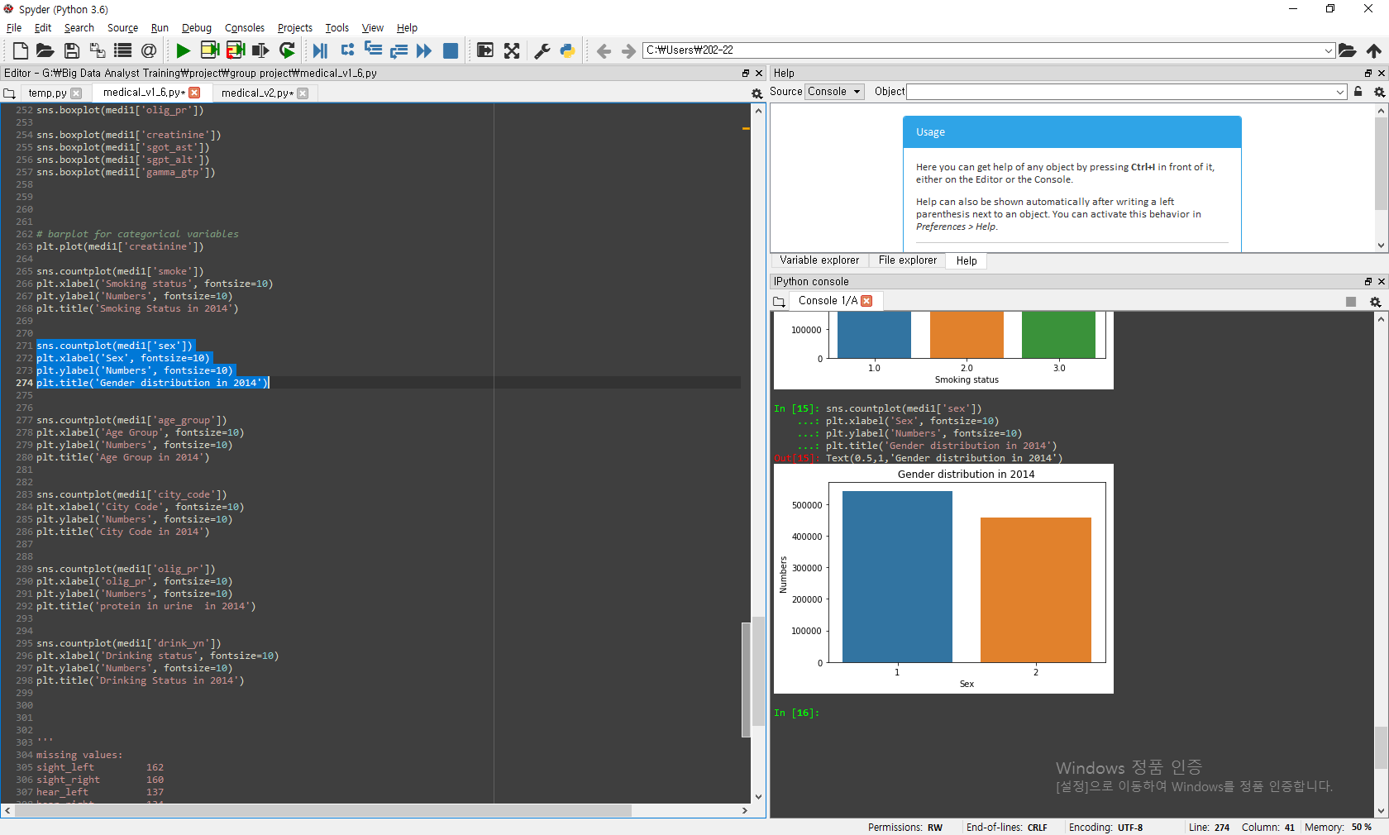
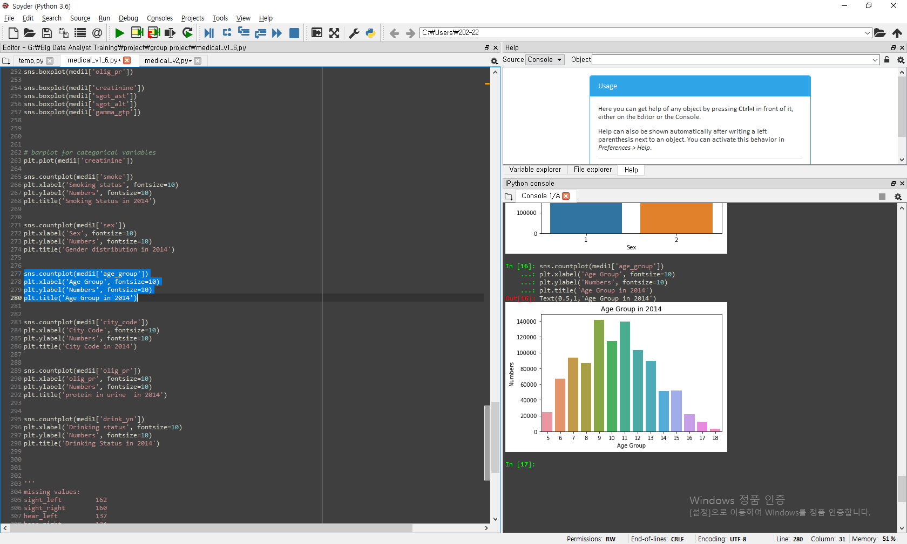
Barplot
sns.countplot(medi1['sex'])
plt.xlabel('Sex', fontsize=10)
plt.ylabel('Numbers', fontsize=10)
plt.title('Gender distribution in 2014')
sns.countplot(medi1['age_group'])
plt.xlabel('Age Group', fontsize=10)
plt.ylabel('Numbers', fontsize=10)
plt.title('Age Group in 2014')
## We observe the age groups between 5-18, not 1-14 which are the original age groups indicated by the Data Portal Site.

Slide 45
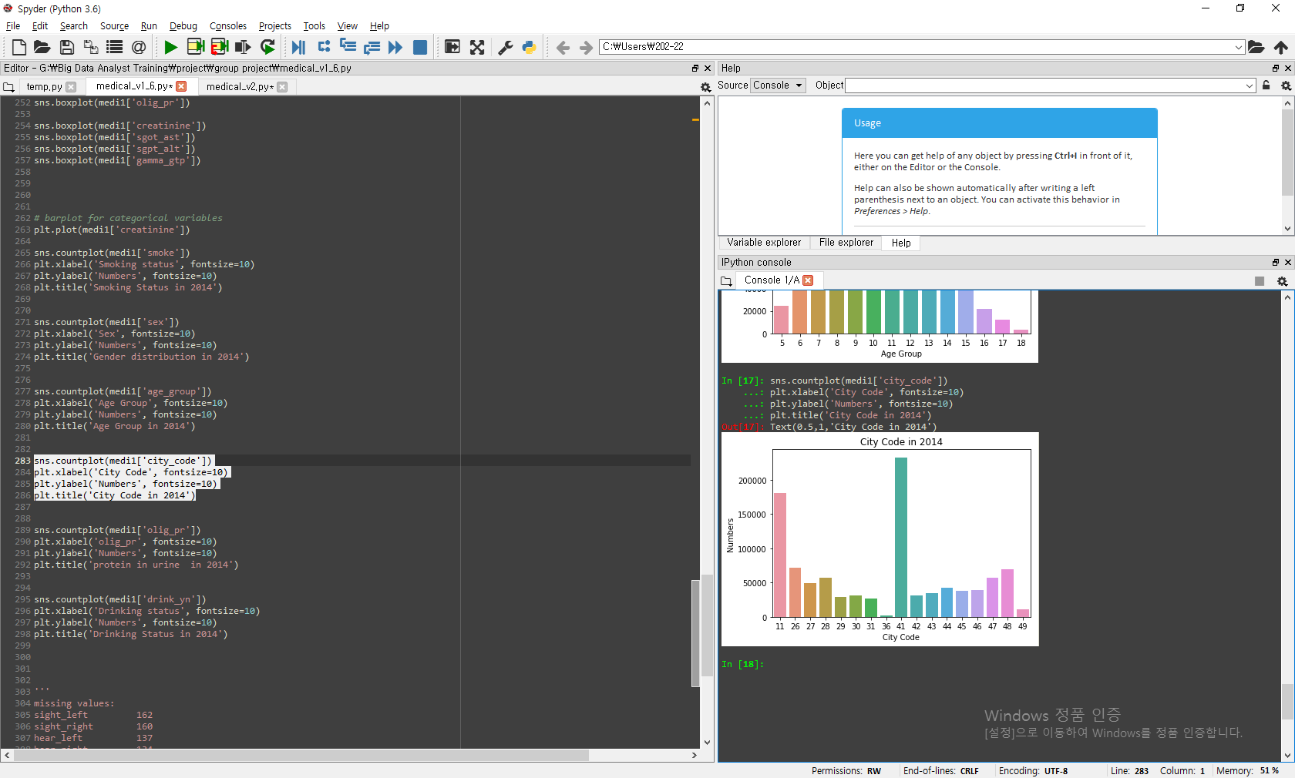
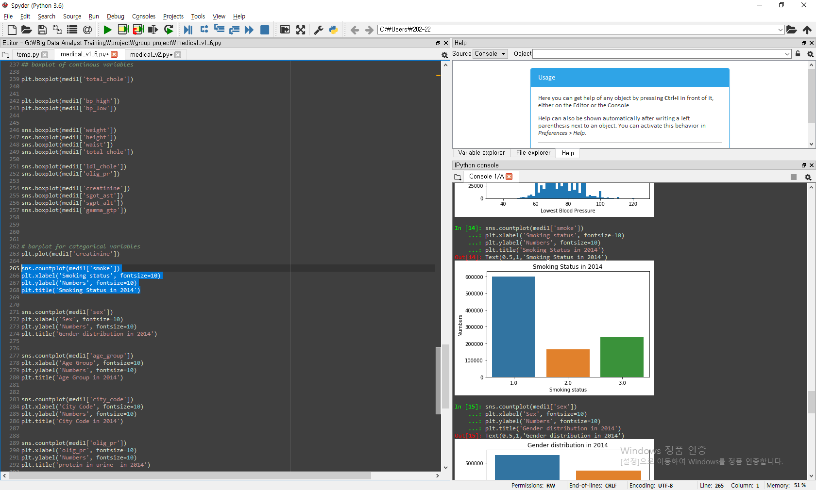
Barplot
sns.countplot(medi1['city_code'])
plt.xlabel('City Code', fontsize=10)
plt.ylabel('Numbers', fontsize=10)
plt.title('City Code in 2014')
##41(Gyeonggi) > 11(Seoul) > 26(Busan) >48(GyeongSangNamDo) > 47(GyeongSangBukDo
sns.countplot(medi1['smoke'])
plt.xlabel('Smoking status', fontsize=10)
plt.ylabel('Numbers', fontsize=10)
plt.title('Smoking Status in 2014')

Slide 46
Data cleaning

Slide 47
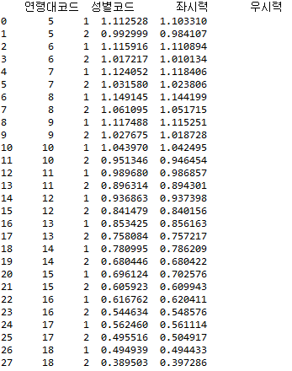
Missing values handling
## Correct values in ‘sight_left’ and ‘sight_right’ for calculating the mean more precisely:
md.loc[md["좌시력"] == 9.9, "좌시력"] = 0.0
md.loc[md["우시력"] == 9.9, "우시력"] = 0.0
means = md.groupby(["연령대코드", "성별코드"], as_index=False)[["좌시력", "우시력"]].mean()
print(means)

Slide 48
Missing values handling
## Handle Missing values in ‘sight_left’ and ‘sight_right’: Fill missing values with the mean by ‘age_group’ & ‘sex’
md["좌시력"].fillna(md.groupby(["연령대코드", "성별코드"])["좌시력"].transform("mean"), inplace=True)
md["우시력"].fillna(md.groupby(["연령대코드", "성별코드"])["우시력"].transform("mean"), inplace=True)
## Handle Missing values in ‘hear_left’ and ‘hear_right’: Make a new category(meaning “NOT ENTERED”)
md.loc[md["좌청력"].isnull(), "좌청력"] = 3
md.loc[md["우청력"].isnull(), "우청력"] = 3

Slide 49
Next step

Slide 50
What’s next
Finish data cleaning - outlier treatment
Find out a concrete subject to predict/classify

Slide 51
Missing value prediction

Slide 52
Missing values handling
medi1.info()
medi1.isnull().sum()
## Missing values:
1/ Drop the missing values for following variables:
‘sight_left’, ‘sight_right’, ‘hear_left’, ‘hear_right’, ‘crs_yn’, ‘ttr_yn’
2/ Fill the missing values with the most frequent values:
‘smoke’, ‘drink_yn’,
3/ Predict the missing values from the prediction model:
‘ldl_chole’: regression analysis
‘olig_prote_cd’, : decision tree
0.0162%
0.0160%
0.0137%
0.0134%
0.4242%
0.4339%
0.0382%
0.0984%
88.995%
61.728%

Slide 53
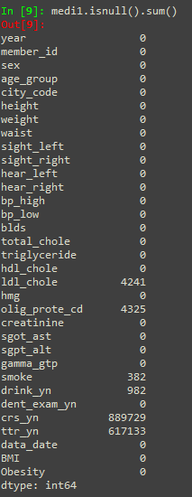
Drop the missing values
Drop the missing values for sight left/right, hear left/right
medi1 = medi1.loc[medi1['sight_left'].notnull()]
medi1 = medi1.loc[medi1['sight_right'].notnull()]
medi1 = medi1.loc[medi1['hear_left'].notnull()]
medi1 = medi1.loc[medi1['hear_right'].notnull()]
medi1.isnull().sum()

Slide 54
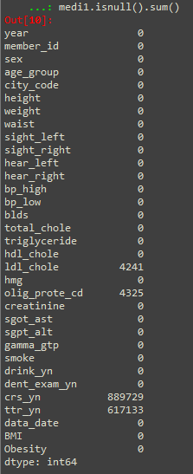
Fill the missing values with the most frequent values
Fill the missing values with the most frequent values:
# smoke
most_freq = medi1['smoke'].mode()
medi1['smoke'].fillna(most_freq[0], inplace=True)
# drink_yn
most_freq1 = medi1['drink_yn'].mode()
medi1['drink_yn'].fillna(most_freq1[0], inplace=True)
medi1.isnull().sum()

Slide 55

Reduction of data dimension
Choose only useful variables: missing only 252 values : drop 'crs_yn' and 'ttr_yn'
c = ['member_id', 'sex', 'age_group', 'city_code', 'height', 'weight', 'waist',
'sight_left', 'sight_right', 'hear_left', 'hear_right',
'bp_high', 'bp_low', 'blds', 'total_chole', 'triglyceride',
'hdl_chole', 'ldl_chole', 'hmg', 'creatinine',
'sgot_ast', 'sgpt_alt', 'gamma_gtp', 'smoke', 'drink_yn',
'dent_exam_yn','BMI', 'Obesity']
medi2 = medi1[c]
medi2.isnull().sum()

Slide 56
Predict missing values with regression analysis
Step1. make a seperate dataset with/without the missing value : train data and test data
## train data
medi3_data = medi2.dropna(axis=0)
medi3_data.isnull().sum()
## test data
medi3_test = medi2.loc[medi2['ldl_chole'].isnull()]
medi3_test.isnull().sum()

Slide 57

Predict missing values with regression analysis
Step 2. separate training/validation data
from sklearn.model_selection import train_test_split
train_set, valid_set = train_test_split(medi3_data, test_size = 0.3)
train_set.shape
valid_set.shape

Slide 58

Predict missing values with regression analysis
Step 3. Make and apply the regression model
import statsmodels.formula.api as sm
from statsmodels.sandbox.regression.predstd import wls_prediction_std
## lm model
lm1 = sm.ols(formula='ldl_chole ~ bp_high+total_chole+hdl_chole+
blds+hmg+BMI+blds+triglyceride+
smoke+drink_yn', data=train_set).fit()
lm1.summary() ## R-squared: 0.643
## lm model validation
pred1 = lm1.predict(valid_set)
actual = valid_set['ldl_chole']
predict1 = pred1
mse_m1 = sum((actual - predict1)**2)/len(actual) # 622.20
rmse_m1 = (mse_m1)**0.5 # 24.94

Slide 59
Predict missing values with regression analysis
Step 4. Choose the regression model
lm1 = sm.ols(formula='ldl_chole ~ bp_high+total_chole+hdl_chole+blds+hmg+BMI+blds+triglyceride+smoke+drink_yn', data=train_set).fit() ## R-squared: 0.643 ## rmse_m1: 24.943
lm2 = sm.ols(formula='ldl_chole ~ sex + height+ weight + blds + total_chole + triglyceride + hdl_chole + hmg + creatinine+sgot_ast+sgpt_alt+gamma_gtp+drink_yn+BMI', data=train_set).fit() ## R-squared: 0.643 ## rmse_m2: 24.93
lm3 = sm.ols(formula='ldl_chole ~ height+ weight + total_chole + hdl_chole+ triglyceride + hmg +BMI', data=train_set).fit()
## R-squared: 0.643 ## rmse_m3: 24.94
>> We choose the lm model 2 for the prediction

Slide 60

Predict missing values with regression analysis
pred_test = lm2.predict(medi3_test)
pred_test.head()
medi3_test['ldl_chole'] = pred_test
medi3_test

Slide 61

Protein in urine
## Check correlation
print(md.corr(method='pearson'))
## Divid data
from sklearn.model_selection import train_test_split
predict = md.loc[md['OLIG_PROTE_CD'].isnull()]
train = md.loc[md['OLIG_PROTE_CD'].isnull() != True]
feat = ['WAIST','BP_STATE','BLDS','CREATININE','GAMMA_GTP']
X_train, X_test, y_train, y_test = train_test_split(train[feat],
train['OLIG_PROTE_CD'], random_state=0)

Slide 62

Protein in urine
## Use Decision Tree
from sklearn.tree import DecisionTreeClassifier
tree = DecisionTreeClassifier(max_depth=15, random_state=0)
tree.fit(X_train, y_train)
## Evaluate a model
from sklearn.metrics import confusion_matrix
print(confusion_matrix(y_test,tree.predict(X_test[feat])))
print(tree.score(X_train,y_train))
print(tree.score(X_test,y_test))
print(tree.feature_importances_)

Slide 63

Protein in urine
## Use Random Forest Classifier
from sklearn.ensemble import RandomForestClassifier
forest = RandomForestClassifier(n_estimators=50, max_depth=15, random_state=0)
forest.fit(X_train, y_train)
## Evaluate a model
from sklearn.metrics import confusion_matrix
print(confusion_matrix(y_test,tree.predict(X_test[feat])))
print(forest.score(X_train, y_train))
print(forest.score(X_test, y_test))
print(forest.feature_importances_)

Slide 64

Protein in urine
## Use Gradient Boosting Classifier
from sklearn.ensemble import GradientBoostingClassifier
gbrt = GradientBoostingClassifier(max_depth=5, random_state=0)
gbrt.fit(X_train, y_train)
## Evaluate a model
from sklearn.metrics import confusion_matrix
print(confusion_matrix(y_test,tree.predict(X_test[feat])))
print(gbrt.score(X_train, y_train))
print(gbrt.score(X_test, y_test))
print(gbrt.feature_importances_)

Slide 65

Protein in urine
## Use K Neighbors Classifier
from sklearn.neighbors import KNeighborsClassifier
clf = KNeighborsClassifier(n_neighbors=15)
clf.fit(X_train, y_train)
## Evaluate a model
from sklearn.metrics import confusion_matrix
print(confusion_matrix(y_test,tree.predict(X_test[feat])))
print(gbrt.score(X_train, y_train))
print(gbrt.score(X_test, y_test))
print(gbrt.feature_importances_)

Slide 66
Protein in urine
## Use Kernelized Support Vector Machines
from sklearn.svm import SVC
svc = SVC(C=10, gamma=10)
svc.fit(X_train, y_train)
## Evaluate a model
from sklearn.metrics import confusion_matrix
print(confusion_matrix(y_test,tree.predict(X_test[feat])))
print(gbrt.score(X_train, y_train))
print(gbrt.score(X_test, y_test))
print(gbrt.feature_importances_)

Slide 67
Predict missing value : Protein in urine
## Predict missing values
md['OLIG_PROTE_CD'].loc[md['OLIG_PROTE_CD'].isnull()] = tree.predict(predict[feat])
print(md['OLIG_PROTE_CD'].isnull().sum())

Slide 68
Q & A

Slide 69

Thank you

